Slide 1

Anomaly Detection of Credit Card Transactions
Using Power BI
A data-driven approach to detect fraudulent activities
By Vikal Kumar Moutghare

Slide 2
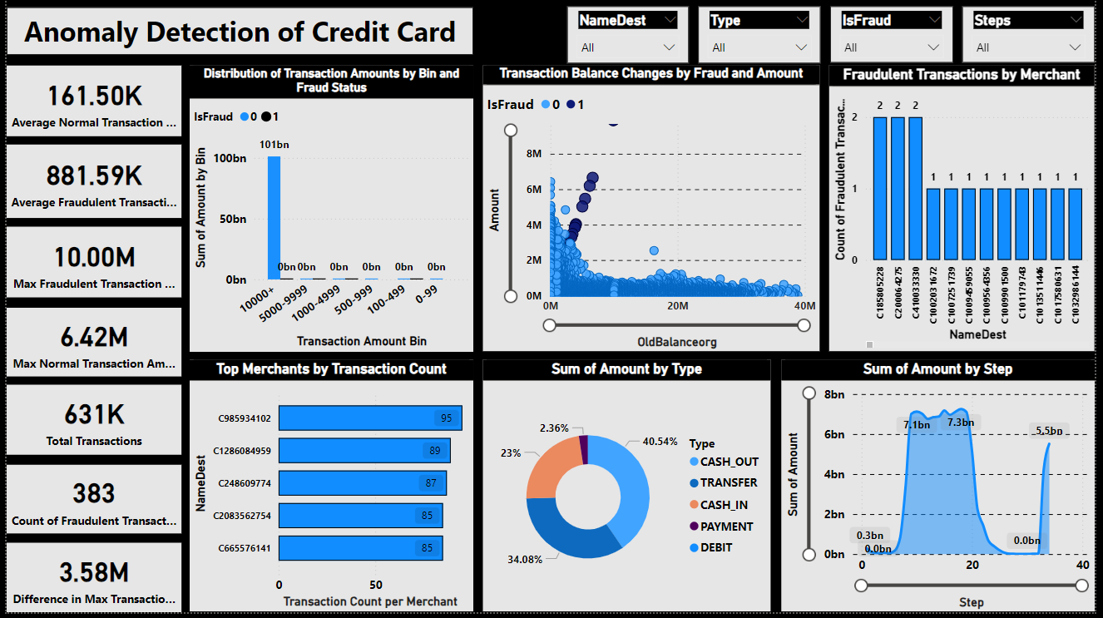
Project Introduction
Project Objective:
Develop a Power BI dashboard to detect and analyze fraudulent credit card transactions.
Scope:
Focus on identifying patterns in fraudulent vs. normal transactions.
Provide insights to help improve the organization’s fraud detection mechanism.
Tools Used: Power BI for data visualization and reporting.

Slide 3
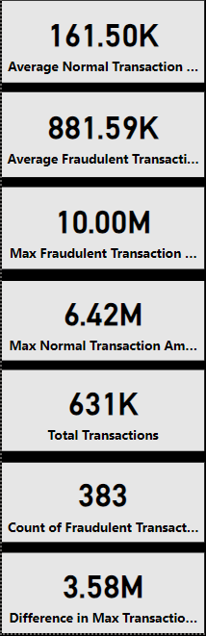
Data Summary
Data Sources:
Credit card transaction dataset including fields like:
Transaction Amount, Fraud Status (IsFraud), Merchant (NameDest), Type of Transaction, Balance, and Time Step.
Key Metrics:
Total Transactions: 631K
Total Fraudulent Transactions: 383
Average Normal Transaction Amount: 161.50K
Average Fraudulent Transaction Amount: 881.59K
Max Fraudulent Transaction Amount: 10M
Max Normal Transaction Amount: 6.42M

Slide 4
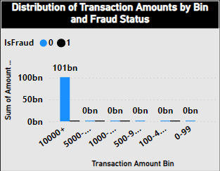
Transaction Amount Distribution by Fraud Status
Visualization: Clustered Column Chart of the distribution of transaction amounts by bin and fraud status.
Key Insight:
Fraudulent transactions tend to have larger amounts, with 101 billion of fraudulent transactions falling in the highest bin of 10,000+.
Normal transactions are typically much smaller and spread across lower bins.

Slide 5
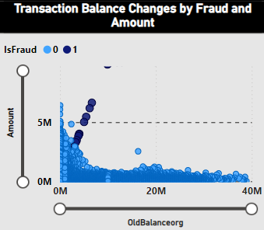
Transaction Balance Changes by Fraud
Visualization: Scatter Plot showing changes in transaction balances (OldBalanceOrg) by fraud status.
Key Insight:
Fraudulent transactions (in blue) show large clusters where transaction amounts significantly differ from the old balance.
Non-fraudulent transactions are more evenly distributed, showing a closer relationship between balance and transaction amounts.

Slide 6
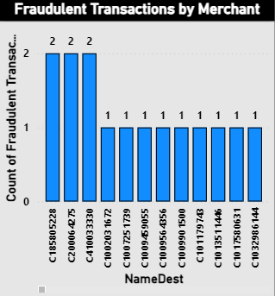
Merchant-Level Fraud Analysis
Visualization: Column Chart of the Top Merchants by Fraudulent Transaction Count.
Key Merchants Involved in Fraud:
Merchant C158859228 and others appear multiple times in the list, indicating a potential pattern of fraud tied to certain merchants.
Investigating these merchants could be crucial for improving fraud detection.
Additional Insight:
The fraudulent merchants show consistent fraud cases even though some have low transaction counts, which suggests targeted attacks.

Slide 7
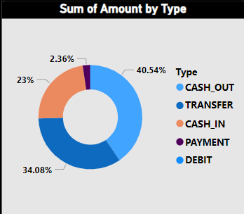
Transaction Type Analysis
Visualization: Donut Chart of Sum of Amount by Transaction Type.
Breakdown of Transaction Types:
CASH_OUT: 40.54% of the total transaction amount, often used in fraud.
TRANSFER: 34.08%, another risky category.
Other types like PAYMENT and DEBIT represent smaller portions, with CASH_IN having the least risk.
Key Insight:
Fraudulent transactions are more common in CASH_OUT and TRANSFER categories, suggesting that monitoring these types is crucial.

Slide 8
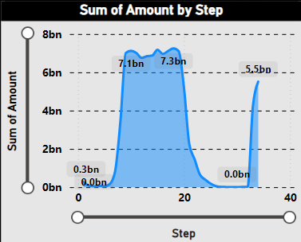
Temporal Analysis of Transactions
Visualization: Line chart of the Sum of Amount by Step.
Key Insight:
Peaks around step 20 and step 35 show large transaction amounts, indicating potential times of concentrated fraudulent activity.
This pattern suggests the need for heightened monitoring during specific periods.

Slide 9
Conclusion
Key Findings:
Significant Fraud Patterns: Large transaction amounts and certain merchants are more likely to be involved in fraud.
Type of Transactions: CASH_OUT and TRANSFER transactions show higher fraud rates.
Time-based Fraud: Fraud tends to happen in bursts, suggesting a need for time-sensitive monitoring systems.
Recommendations:
Implement more stringent controls for large transactions and high-risk merchants.
Apply machine learning algorithms to improve fraud prediction based on patterns observed.

